Slide 1
ISP Final Project
Jinyong Jun, Claire Kim

Slide 2
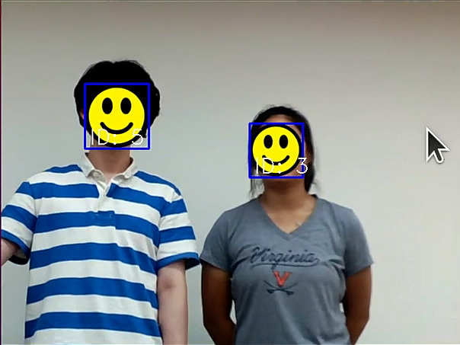
Goal
The main objective of this project is to develop a face-blurring program that offers real-time face detection, tracking, and automated blurring capabilities. Additionally, the program includes a user interface to allow manual selection for tracing and obscuring faces, ensuring privacy compliance when effortlessly recording videos.

Slide 3
Demo

Slide 4
Technologies
Face detector
HOG (Histogram of Oriented Gradients)
Linear SVM (Support Vector Machine)
Face Landmark Detection
Regression tree methods
Face Recognition
ResNet-34 model

Slide 5
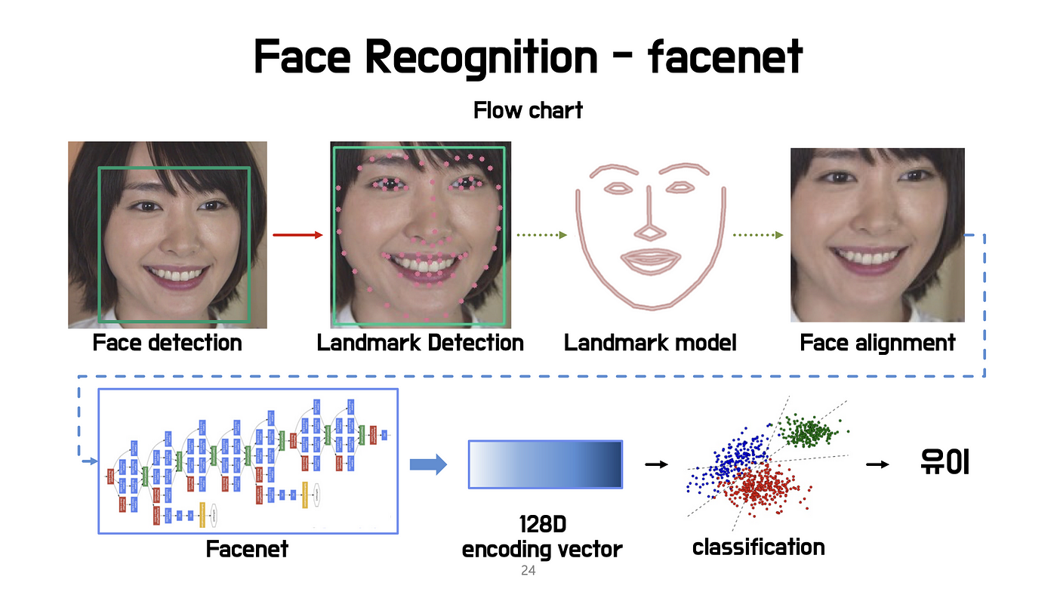
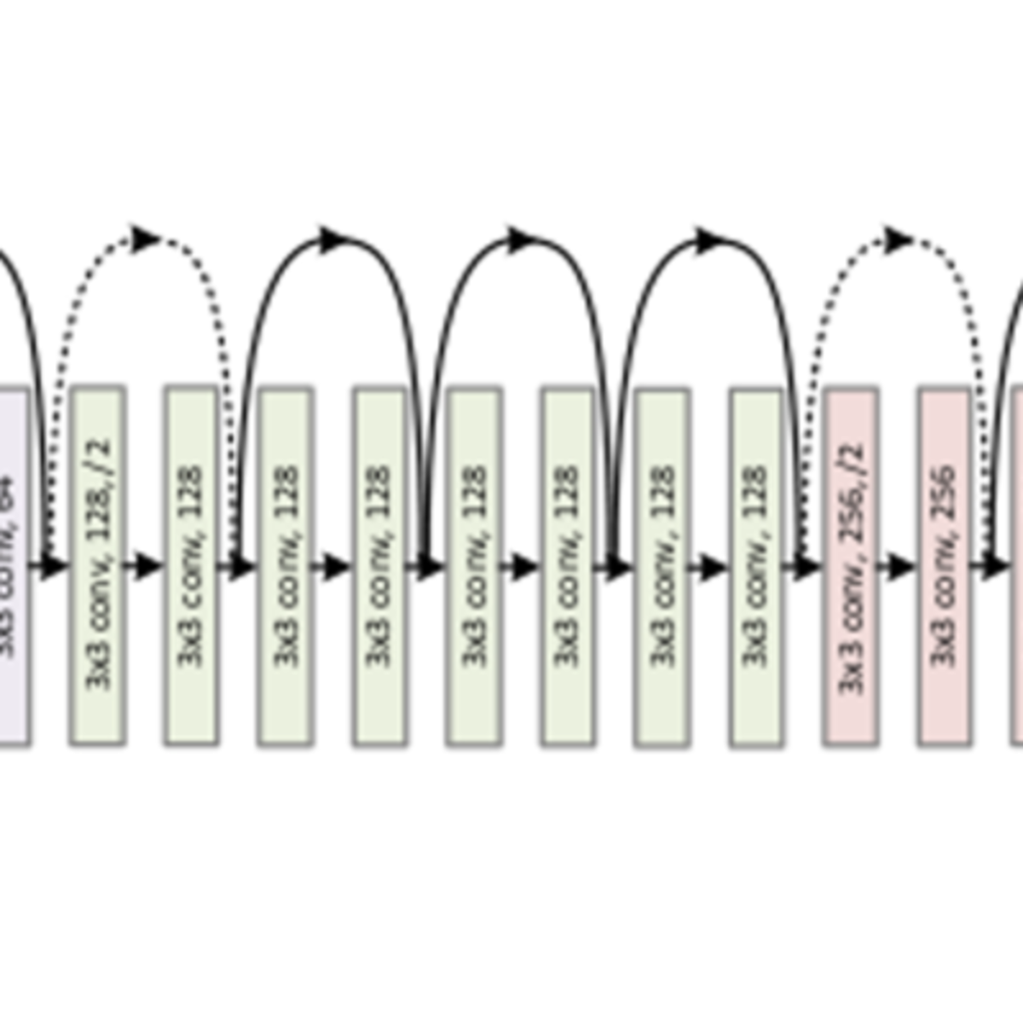
Technologies
Face Recognition Process
ID: 0
ResNet

Slide 6
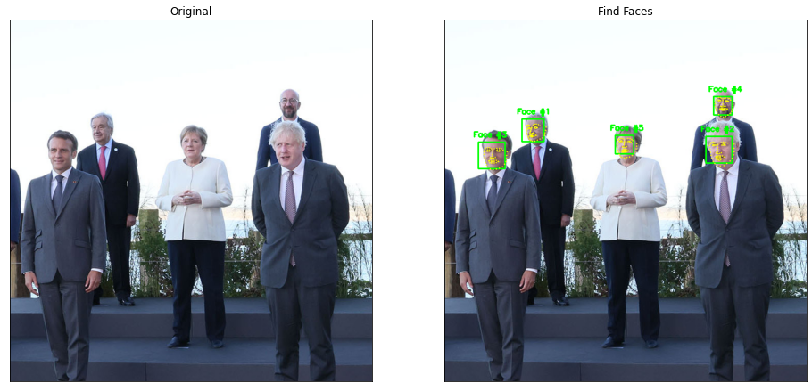
Technologies: Face Detection

Slide 7
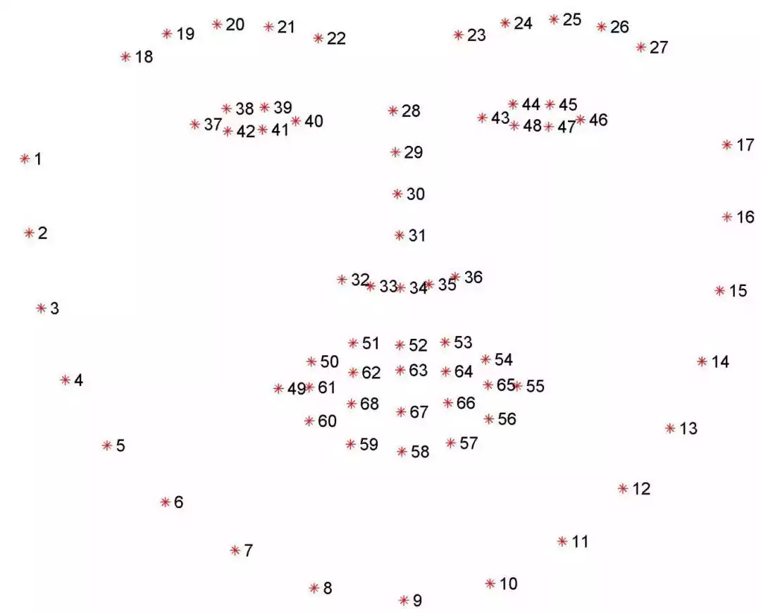
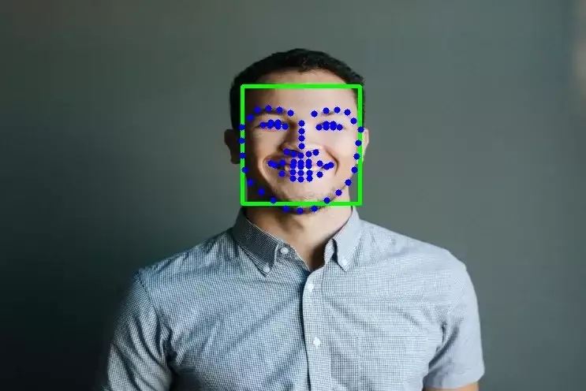
Technologies: Face Landmark Detection

Slide 8
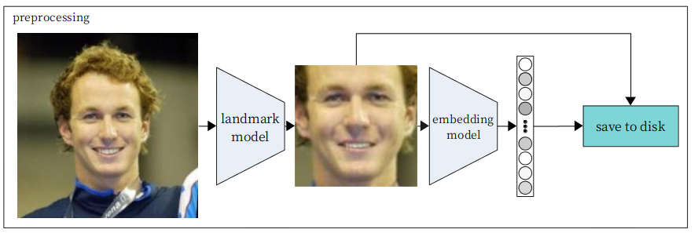
Technologies: Face Recognition

Slide 9
Implementations:
Automated Face Tracking for Main Person
Selective Face Blurring for Bystanders
User Interface for Main Person Tracking and Selective Face Blurring

Slide 10
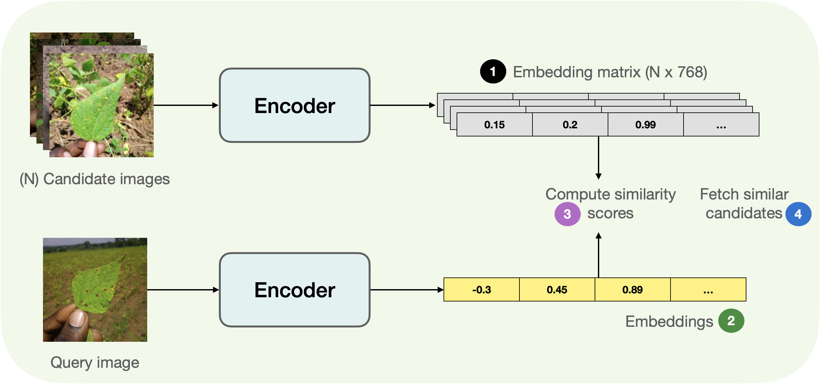


Implementations: Face Recognition Based on Face Embeddings

Slide 11


Implementations: Face Database for Unknown Face Classification
ID: 3

Slide 12

Results
Code works as expected
Can identify major facial features (such as the eyes, nose, and mouth)
Utilizes an identification system to track different faces concurrently
Users can cover a person’s face with an emoji by simply clicking on it

Slide 13
Limitations
The camera utilized in this project cannot capture real-time movement accurately. It takes a bit of time for the camera to process what it captures
The camera required external height adjustments to acquire accurate capturing of faces
The face recognition model implemented in this project can only recognize faces directly facing the camera; side profiles are not easily recognized
Only one emoji option

Slide 14
Conclusion
The face-blurring program effectively detects and blurs faces in real-time videos
Introduces a face database for unknown face detection, allowing recognition without pre-training
However, there are limitations, such as camera delays and model performance
Future improvements include refining camera systems, enhancing face recognition, and adding more blurring options to increase versatility
Overall, the project lays the foundation for privacy-conscious video recording solutions

